Slide 1

Django REST framework
With Machine Learning

Slide 2



What is an API?
API stands for Application Programming Interface
It acts as a two-way communication bridge between frontend and backend
HTTP request
REST API
HTTP response
Client
Server
Frontend & Backend Communication

Slide 3
What is REST API?
REST stands for Representational State Transfer
It organizes how web applications talk to each other, separating what the user sees (frontend) from what runs behind the scenes (backend).

Slide 4
Core Principles of REST
Stateless:
The server doesn't store any information about the client between requests.
Client-Server Architecture:
The app (client) asks for things (data) and the server does what's requested (sends data or makes changes).

Slide 5
Core Principles of REST
Standardized Interface:
REST APIs rely on a set of standard methods (GET, POST, PUT, DELETE) for interacting with resources.
GET - retrieving the resource
PUT - updating the resource
POST - creating the resource
DELETE - deleting the resource

Slide 6
Core Principles of REST
Easy-to-Read Data:
REST APIs returns the response in a standardized easy to read formats, typically JSON or XML formats.

Slide 7
RESTful Operations
GET, POST, PUT, DELETE
URI
GET /students
POST /students
PUT /student/1
DELETE /student/1

Slide 8
Virtual Environment

Slide 9
Web Application Endpoints
Users can directly access it from the web browsers
http://127.0.0.1:8000/students/

Slide 10
API Endpoints
Returns the data to integrate into the frontend.
http://127.0.0.1:8000/api/v1/students/

Slide 11
Serializers
Serialization is the process of converting the model object or a queryset into JSON format or any other formats that the client requires.

Slide 12
Class Based Views
Class-based views provide more structured and organized way to handle requests using Object-oriented principles.
get()
Get the students
post()
Create a student
put()
Update a student
delete()
Delete a student

Slide 13
Mixins
Mixins are reusable code classes in object-oriented programming that provide specific functionalities.
In Django REST Framework, mixins are used to add common functionality to views.
Create
Read
Update
Delete

Slide 14
Mixins
class Employees(mixins, generics.GenericAPIView)
ListModelMixin
list()
generics.GenericAPIView
get()
CreateModelMixin
create()
post()
RetriewModelMixin
retrieve()
put()
UpdateModelMixin
update()
delete()
DestroyModelMixin
destroy()
{
"id": 1,
"name": "John Doe",
”designation": ”Software Engineer"
}

Slide 15
Mixins
class Employees(mixins.ListModelMixin, generics.GenericAPIView):
def get(self, request):
ListModelMixin
return self.list(request)
CreateModelMixin
class Employees(mixins.ListModelMixin, mixins.CreateModelMixin, generics.GenericAPIView):
RetriewModelMixin
def get(self, request):
UpdateModelMixin
return self.list(request)
DestroyModelMixin
def post(self, request):
return self.create(request)

Slide 16
Generics
ListAPIView
For listing the objects
CreateAPIView
For creating the objects
RetrieveAPIView
For retrieving a single object using pk
UpdateAPIView
For updating a single object using pk
DestroyAPIView
For deleting an object using pk
ListCreateAPIView
For listing and creating objects
RetrieveUpdateAPIView
For retrieving & updating objects using pk
RetrieveUpdateDestroyAPIView
For retrieving, updating & deleting objects using pk

Slide 17
Viewsets
list()
create()
viewsets.ViewSet
retrieve()
update()
delete()
viewsets.ModelViewSet
Takes only queryset and serializer_class and automatically provides both pk based and non-pk based operations.

Slide 18
Pagination
PageNumberPagination
page_size = 10
/blogs/?page=10
Takes a page_size parameter and returns the response accordingly.
LimitOffsetPagination
Limit: This parameter controls how many items you want to see in a single page.
/blogs/?limit=10&offset=0
Offset: This parameter tells the API where to start fetching the items from.
If offset=0, you get the first 10 blogs (items 1-10).
/blogs/?limit=10&offset=0
If offset=10, you get the next 10 blogs (items 11-20).
/blogs/?limit=10&offset=10
If offset=90, you get the last 10 blogs (items 91-100).
/blogs/?limit=10&offset=90

Slide 19
Filtering
Use Case 1: Filter Employees by Designation
Criteria: Retrieve all employees with the designation "Software Engineer."
Use Case 2: Filter Employees by Name
Criteria: Retrieve all employees whose names contain the word "John."
Use Case 3: Filter Employees by ID Range
Criteria: Retrieve all employees with IDs between ”EMP002" and ”EMP006."

Slide 20
React Introduction
React is a JavaScript library for building user interfaces, especially single-page applications.
Created and used by Facebook. Also used by: Instagram, Netflix, Airbnb and Udemy.
Helps you create reusable pieces of a website, called components.

Slide 21


Components
Components are the building blocks of a React app. Each component is a small piece of code that does one specific thing.
Reusable code blocks

Slide 22
Virtual DOM
Updates the part of a page where it is needed. No full page refresh.
Superfast and responsive, even with complex interactions.

Slide 23
State
In React, state is a special object that holds data that can change over time
Unlike props, which are passed down from parent to child components, state is managed within the component itself.
Hooks
Hooks are special functions in React that allows you to use state and other React features in functional components
Hooks make your code easier to understand and share logic between the components.

Slide 24
Built-in Hooks in React
useState
useEffect
useContext
useReducer
useRef
useMemo
useCallback
Custom hooks…

Slide 25
UseEffect
It’s a hook that lets you perform side effects in your functional components
Side Effect
Any action that affects something outside the scope of your component can be considered a side effect
Fetching data from an API
Subscribing to a data stream
Manually changing the DOM

Slide 26
UseMemo
useMemo is a hook that memorizes a value. It remembers the result of a function.
Avoid expensive calculations on every render

Slide 27
Prop Drilling
Parent
Child A
Child B
Child C

Slide 28
UseRef
Used to access and interact with DOM elements directly.
Used to store mutable values that doesn’t trigger a component re-render.
useRef can hold the previous state value
DOM – Document Object Model

Slide 29
Access Token & Refresh Token
refreshToken
Authorization header
– lifespan 5 mins
accessToken
refreshToken
Valid access token
Frontend
http://127.0.0.1:8000/api/v1/protected-view/
Backend
Request
Response
{‘status’: ‘success’}
{‘status’: ‘401 Unauthorized}
{‘status’: ‘’success}
New accessToken

Slide 30
Axios Interceptors
Interceptors are a feature that allows you to modify requests and responses before they are handled by the success handler or error handler.
Request Interceptors:
Request interceptors are used to modify requests before they are sent to the server.
Response Interceptors:
Response interceptors are used to handle responses before they reach your then or catch methods. (Success handlers or error handlers)
Intercept
accessToken
refreshToken
Modify this request & add Authorization header
Frontend
http://127.0.0.1:8000/api/v1/protected-view/
Backend
Request
Response
Intercept
Check this response for 401 status & use refreshToken to get the new accessToken

Slide 31
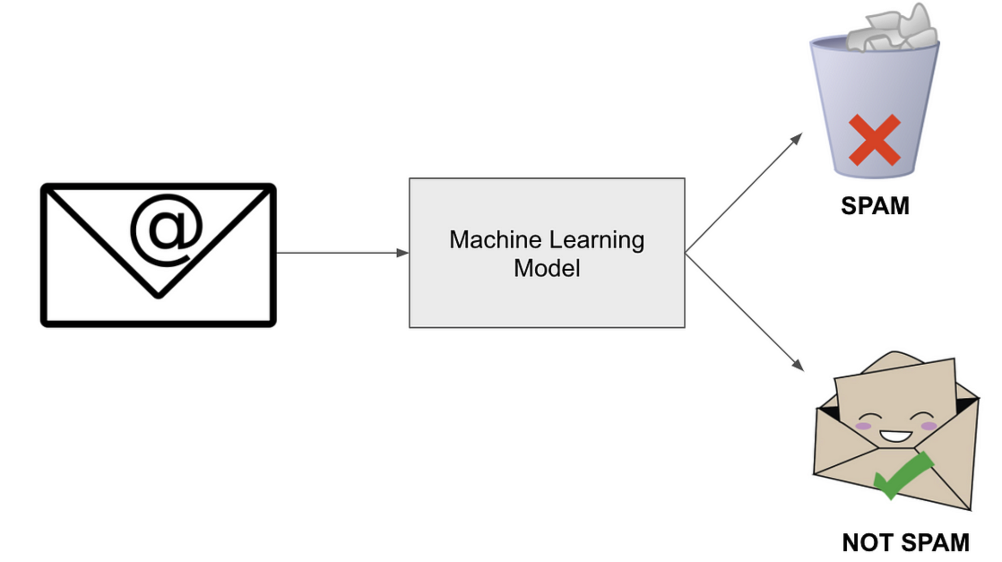

Machine Learning
Machine learning is a subset of artificial intelligence where computers learn from data and make decisions.
It’s like teaching a computer to recognize patterns and make predictions based on those patterns.

Slide 32
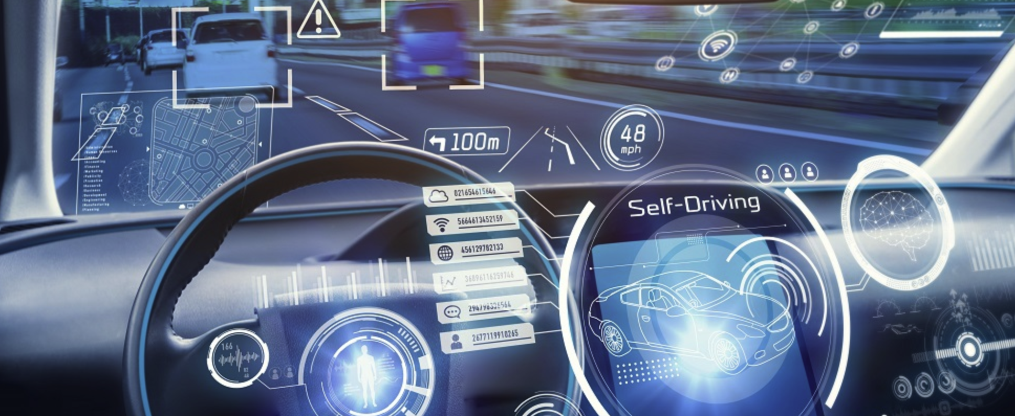

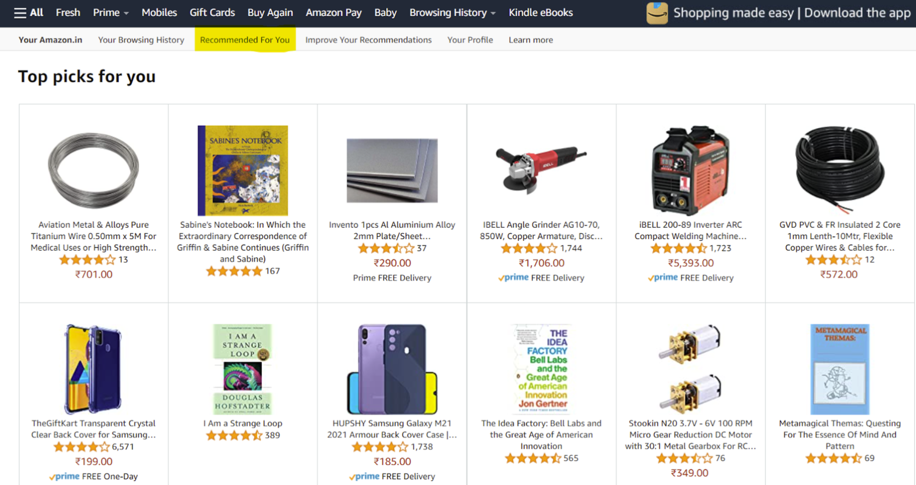
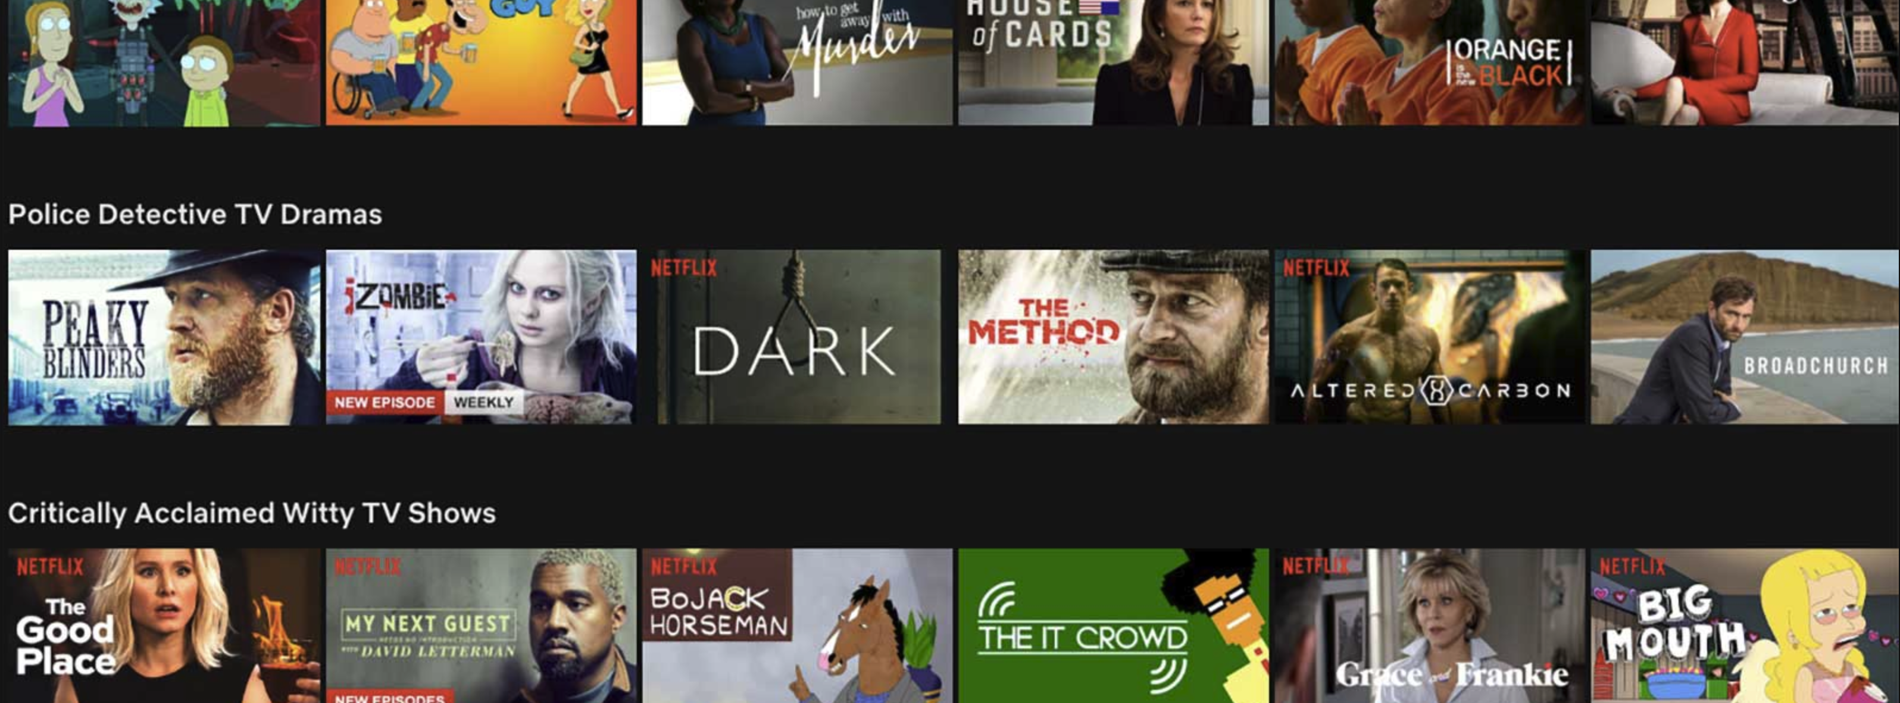

Slide 33
Machine Learning
Supervised Learning
Unsupervised Learning
Reinforcement Learning
Classification
Regression
Model-based
Model-free
Clustering
Dimensionality Reduction
Associate Rule Mining

Slide 34
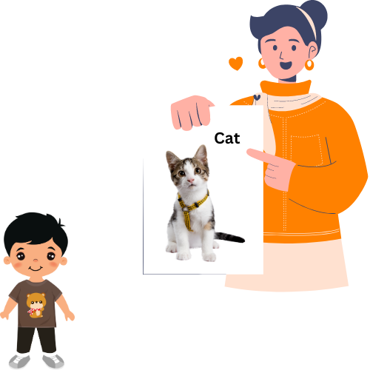
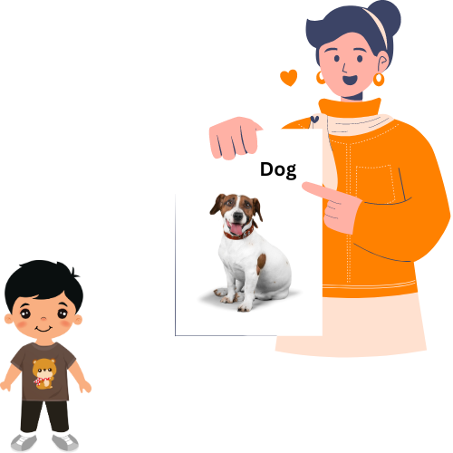
Supervised Learning
This is a type of machine learning where a computer is trained using a dataset that includes both the input data and the correct output.

Slide 35


Supervised Learning
This is a type of machine learning where the computer is trained on a dataset that includes both the input data and the correct output.
?
It’s a Cat

Slide 36

Supervised Learning
This is a type of machine learning where the computer is trained on a dataset that includes both the input data and the correct output.
Cat
Label
Data point

Slide 37

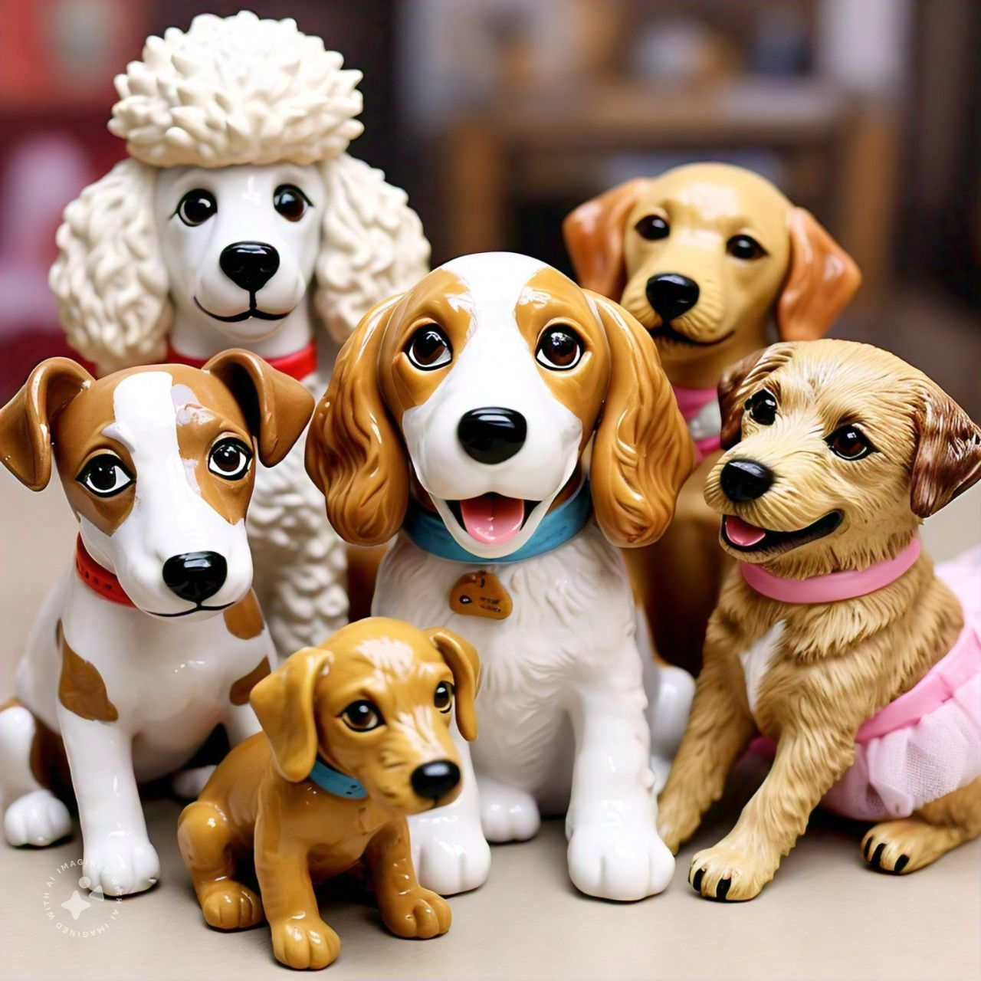

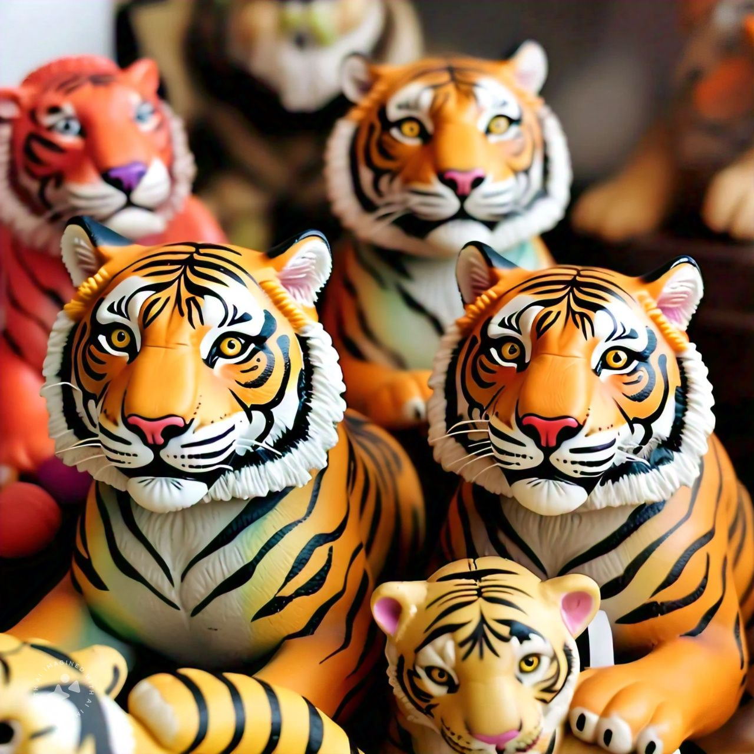
Unsupervised Learning
This is a type of machine learning where a computer is trained on unlabelled data.
The goal is to identify the patterns, or structures within the data without any labels.
Grouped

Slide 38



Reinforcement Learning
This is a type of machine learning where a computer learns to make better decisions by receiving rewards or penalties for its actions.
Correct actions:
Positive feedback (Reward)
Incorrect actions:
Negative feedback (Penalty)

Slide 39
Comparative view of AI, ML, DL and GenAI
Artificial Intelligence
Machine Learning
Deep Learning
Generative AI

Slide 40
Classification
Classification is a type of supervised learning where the goal is to predict a label or category based on input data.
Cat
Label
Data point

Slide 41
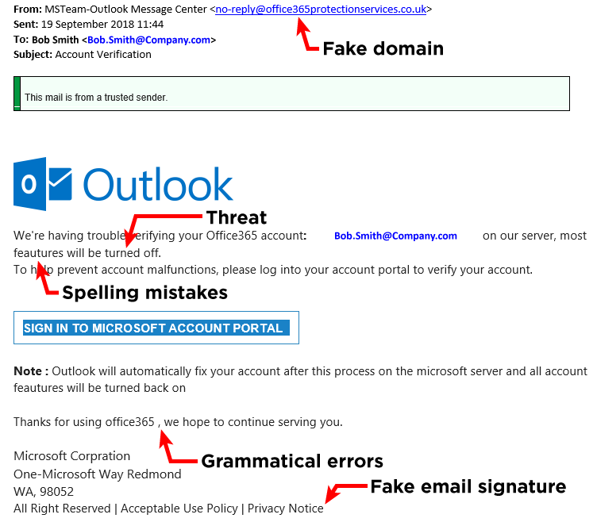
Classification
Classification is a type of supervised learning where the goal is to predict a label or category based on input data.

Slide 42
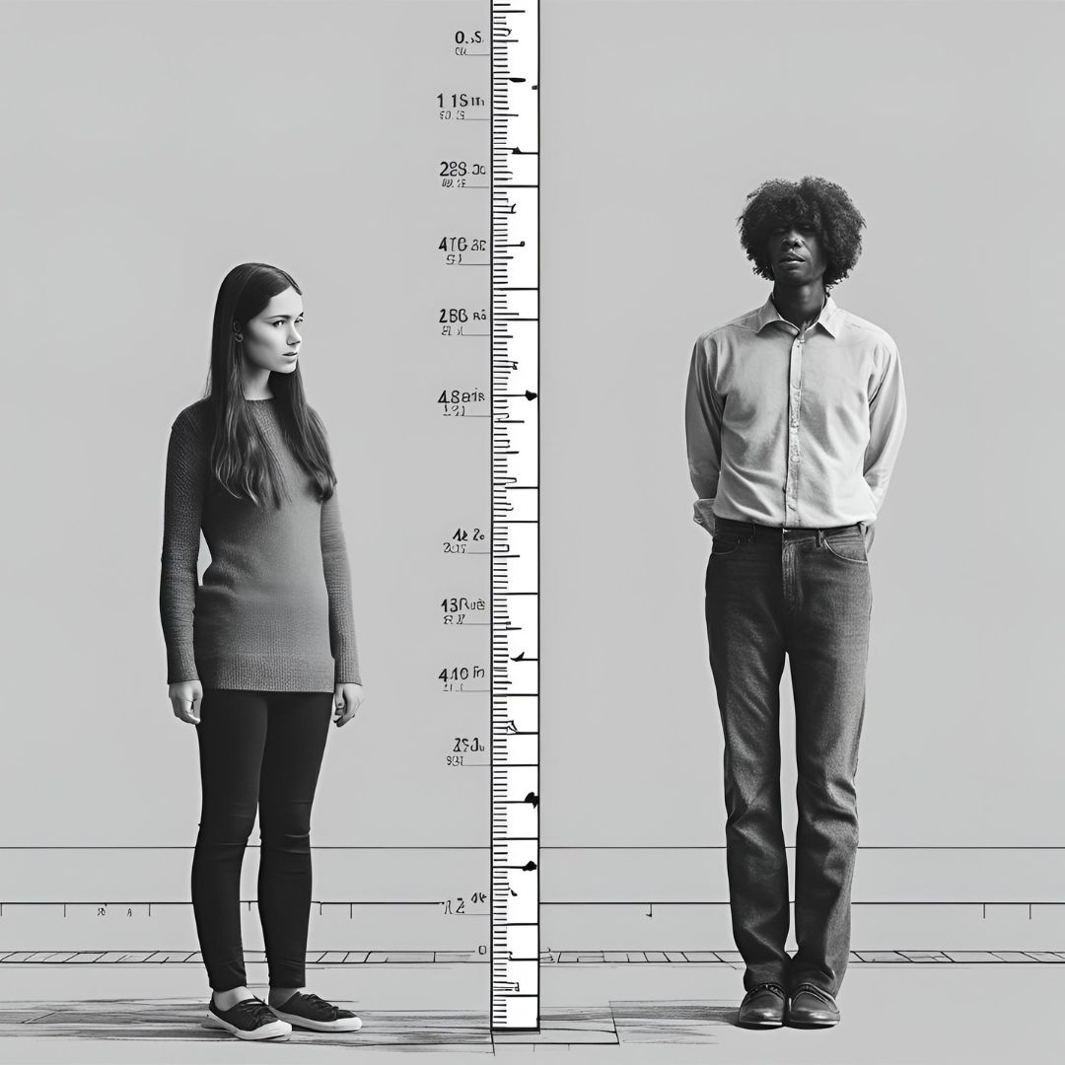
Regression
Regression is a type of supervised learning where the goal is to predict a continuous numerical value.
Height Prediction
You might look at their age
You might look at their parents height
Features
You might consider their shoe size

Slide 43
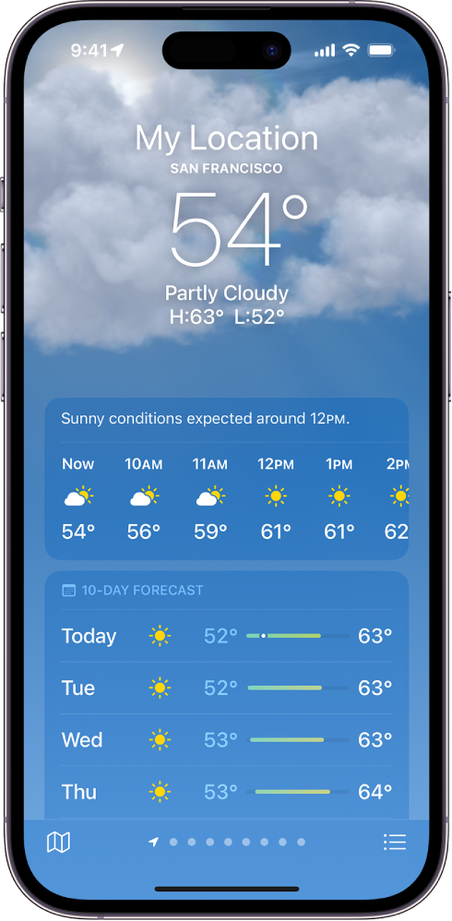
Weather Prediction
Regression
Regression is a type of supervised learning where the goal is to predict a continuous numerical value.
Predicts an actual temperature

Slide 44
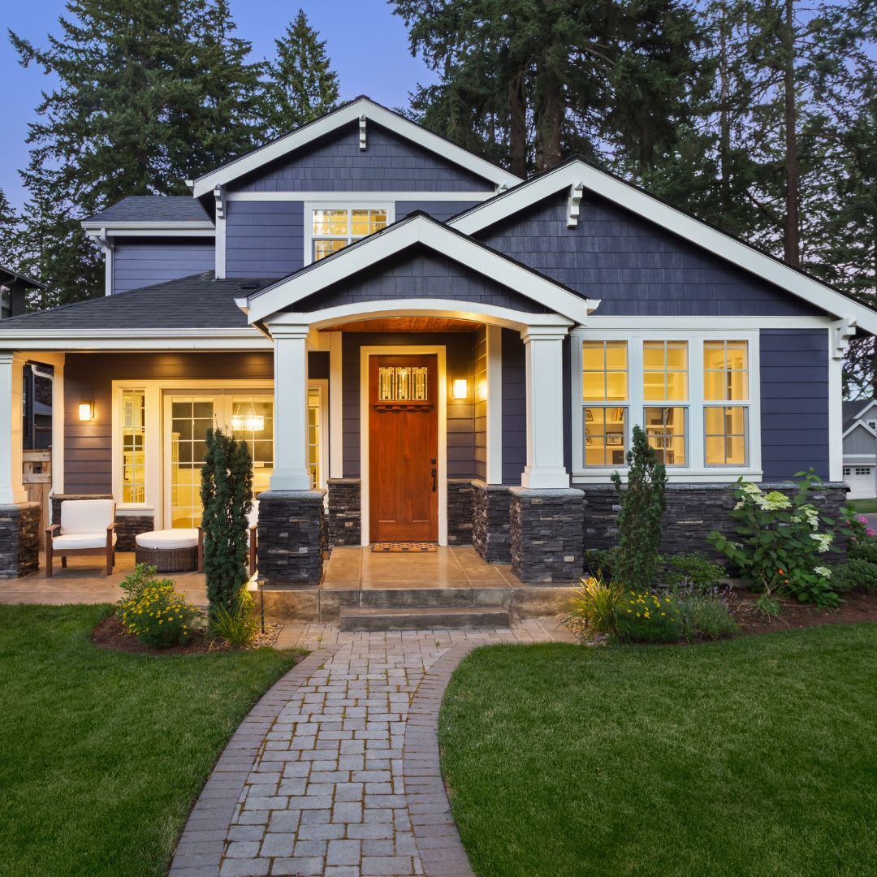
Regression
Regression is a type of supervised learning where the goal is to predict a continuous numerical value.
House Price Prediction
No. of bedrooms
Area of house in Sqft
Features
Locality
Past sold price

Slide 45
Understanding the problem statement
Stock prices change constantly and are influenced by numerous factors from the past.
Reacts to the human emotions.
Follows market trends (uptrends & downtrends)
…many other complex factors
LSTM – Long Short-Term Memory
LSTMs are like regression models with a built-in memory

Slide 46
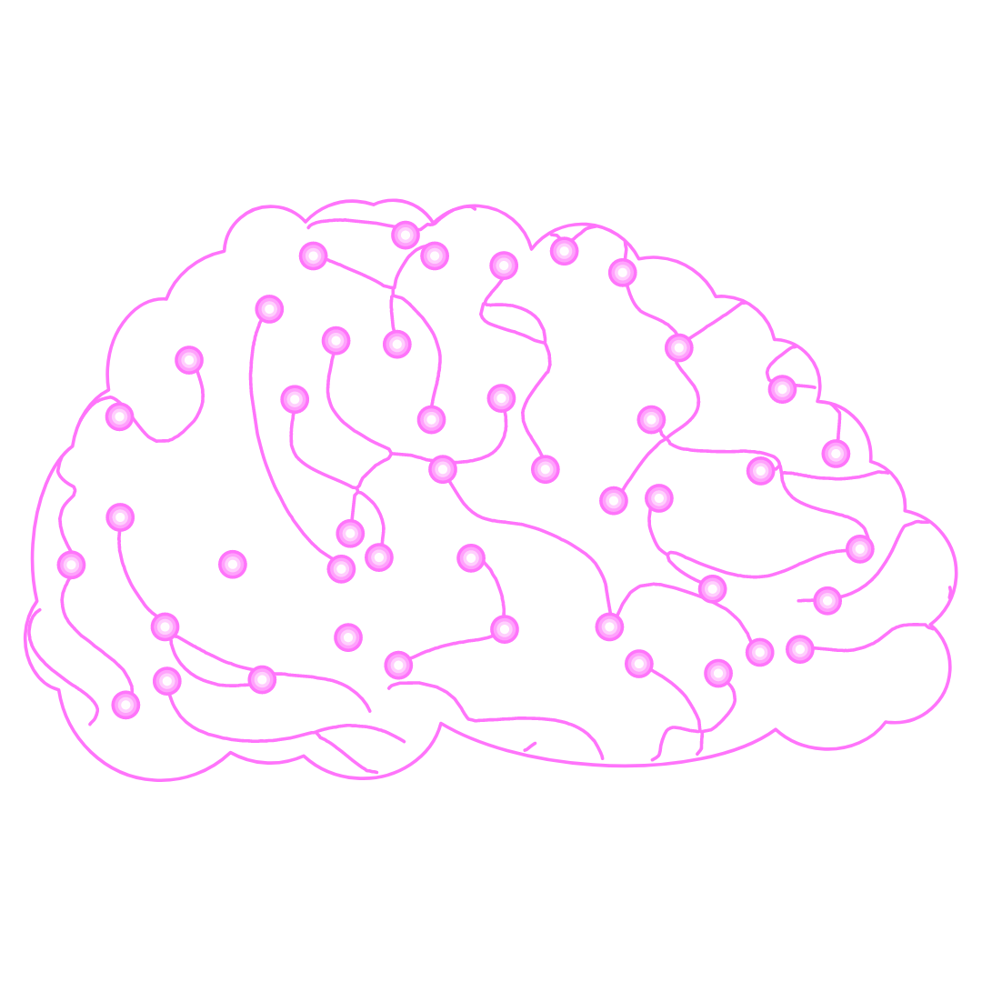
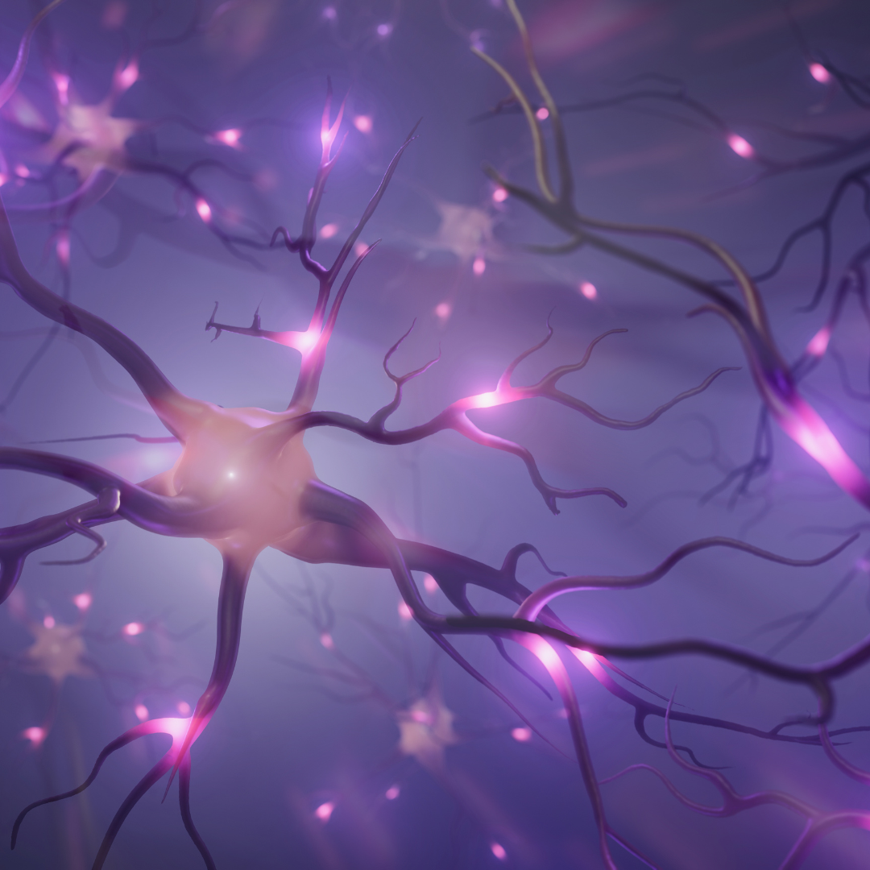
Deep Learning
Neural Networks
Neural networks are a type of machine learning model inspired by the structure and function of the human brain.

Slide 47
Machine Learning
Collection of tools (algorithms) designed for different tasks.
We use Machine Learning algorithms to solve simpler tasks.
Predicting the weather, spam email classification, etc.
Deep Learning
Deep learning is a subset of Machine Learning that uses more complex algorithms, like neural networks.
We use Deep Learning algorithms to solve complex tasks.
Image recognition, Natural Language Processing, Sentiment Analysis, etc

Slide 48
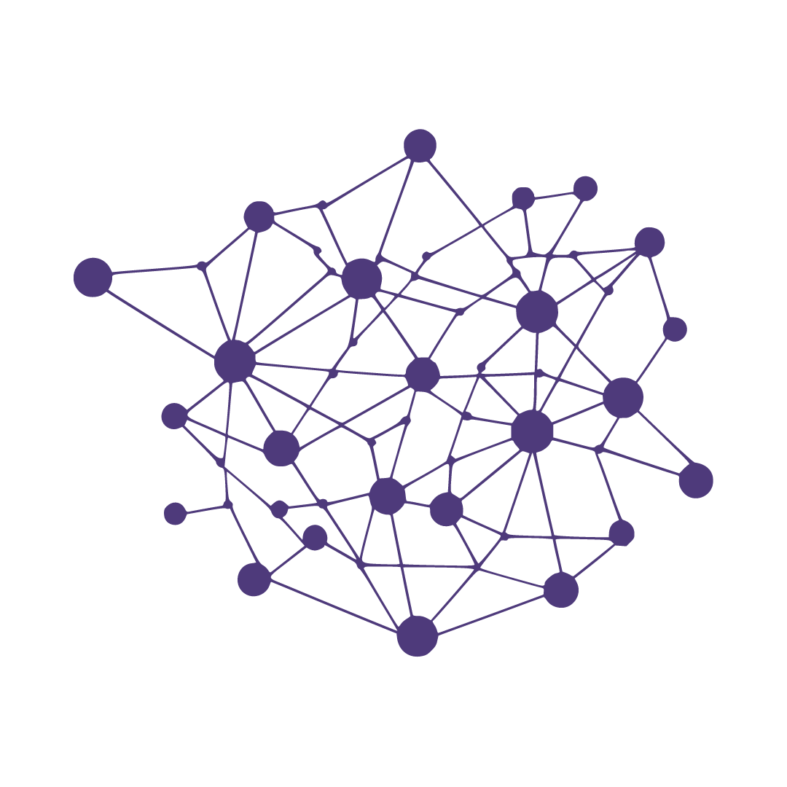
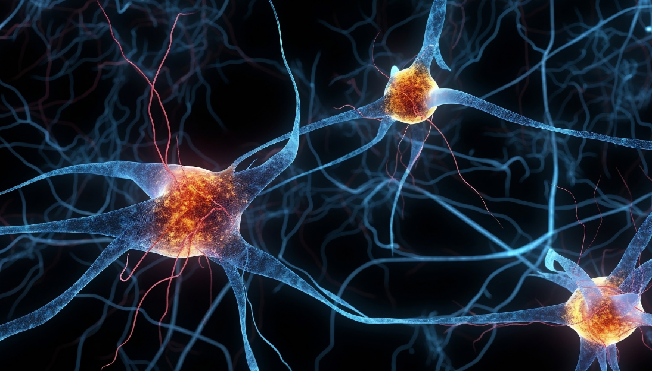
Neural Networks
In deep learning, a neural network is a model that mimics the human brain to recognize patterns and make predictions.
Nodes (Neurons)

Slide 49
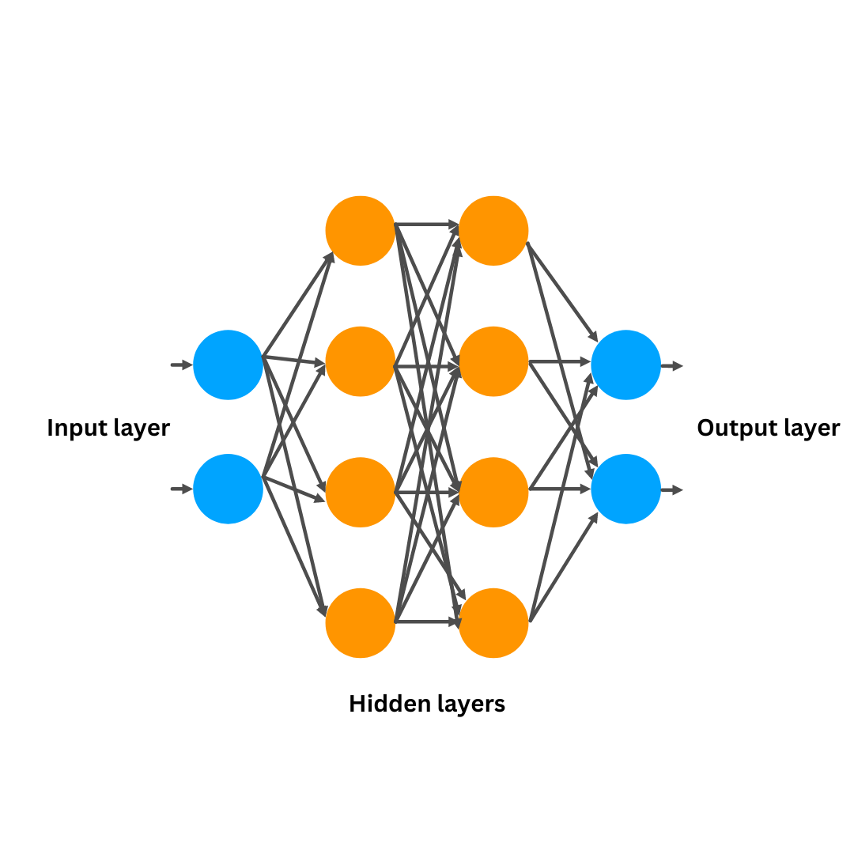
Neural Network Architecture
Input Layer:
Feed the data to the neural network
Hidden Layers:
Process and analyse the data by extracting features & patterns.
Output Layer:
Produces the final result, like a prediction or classification

Slide 50
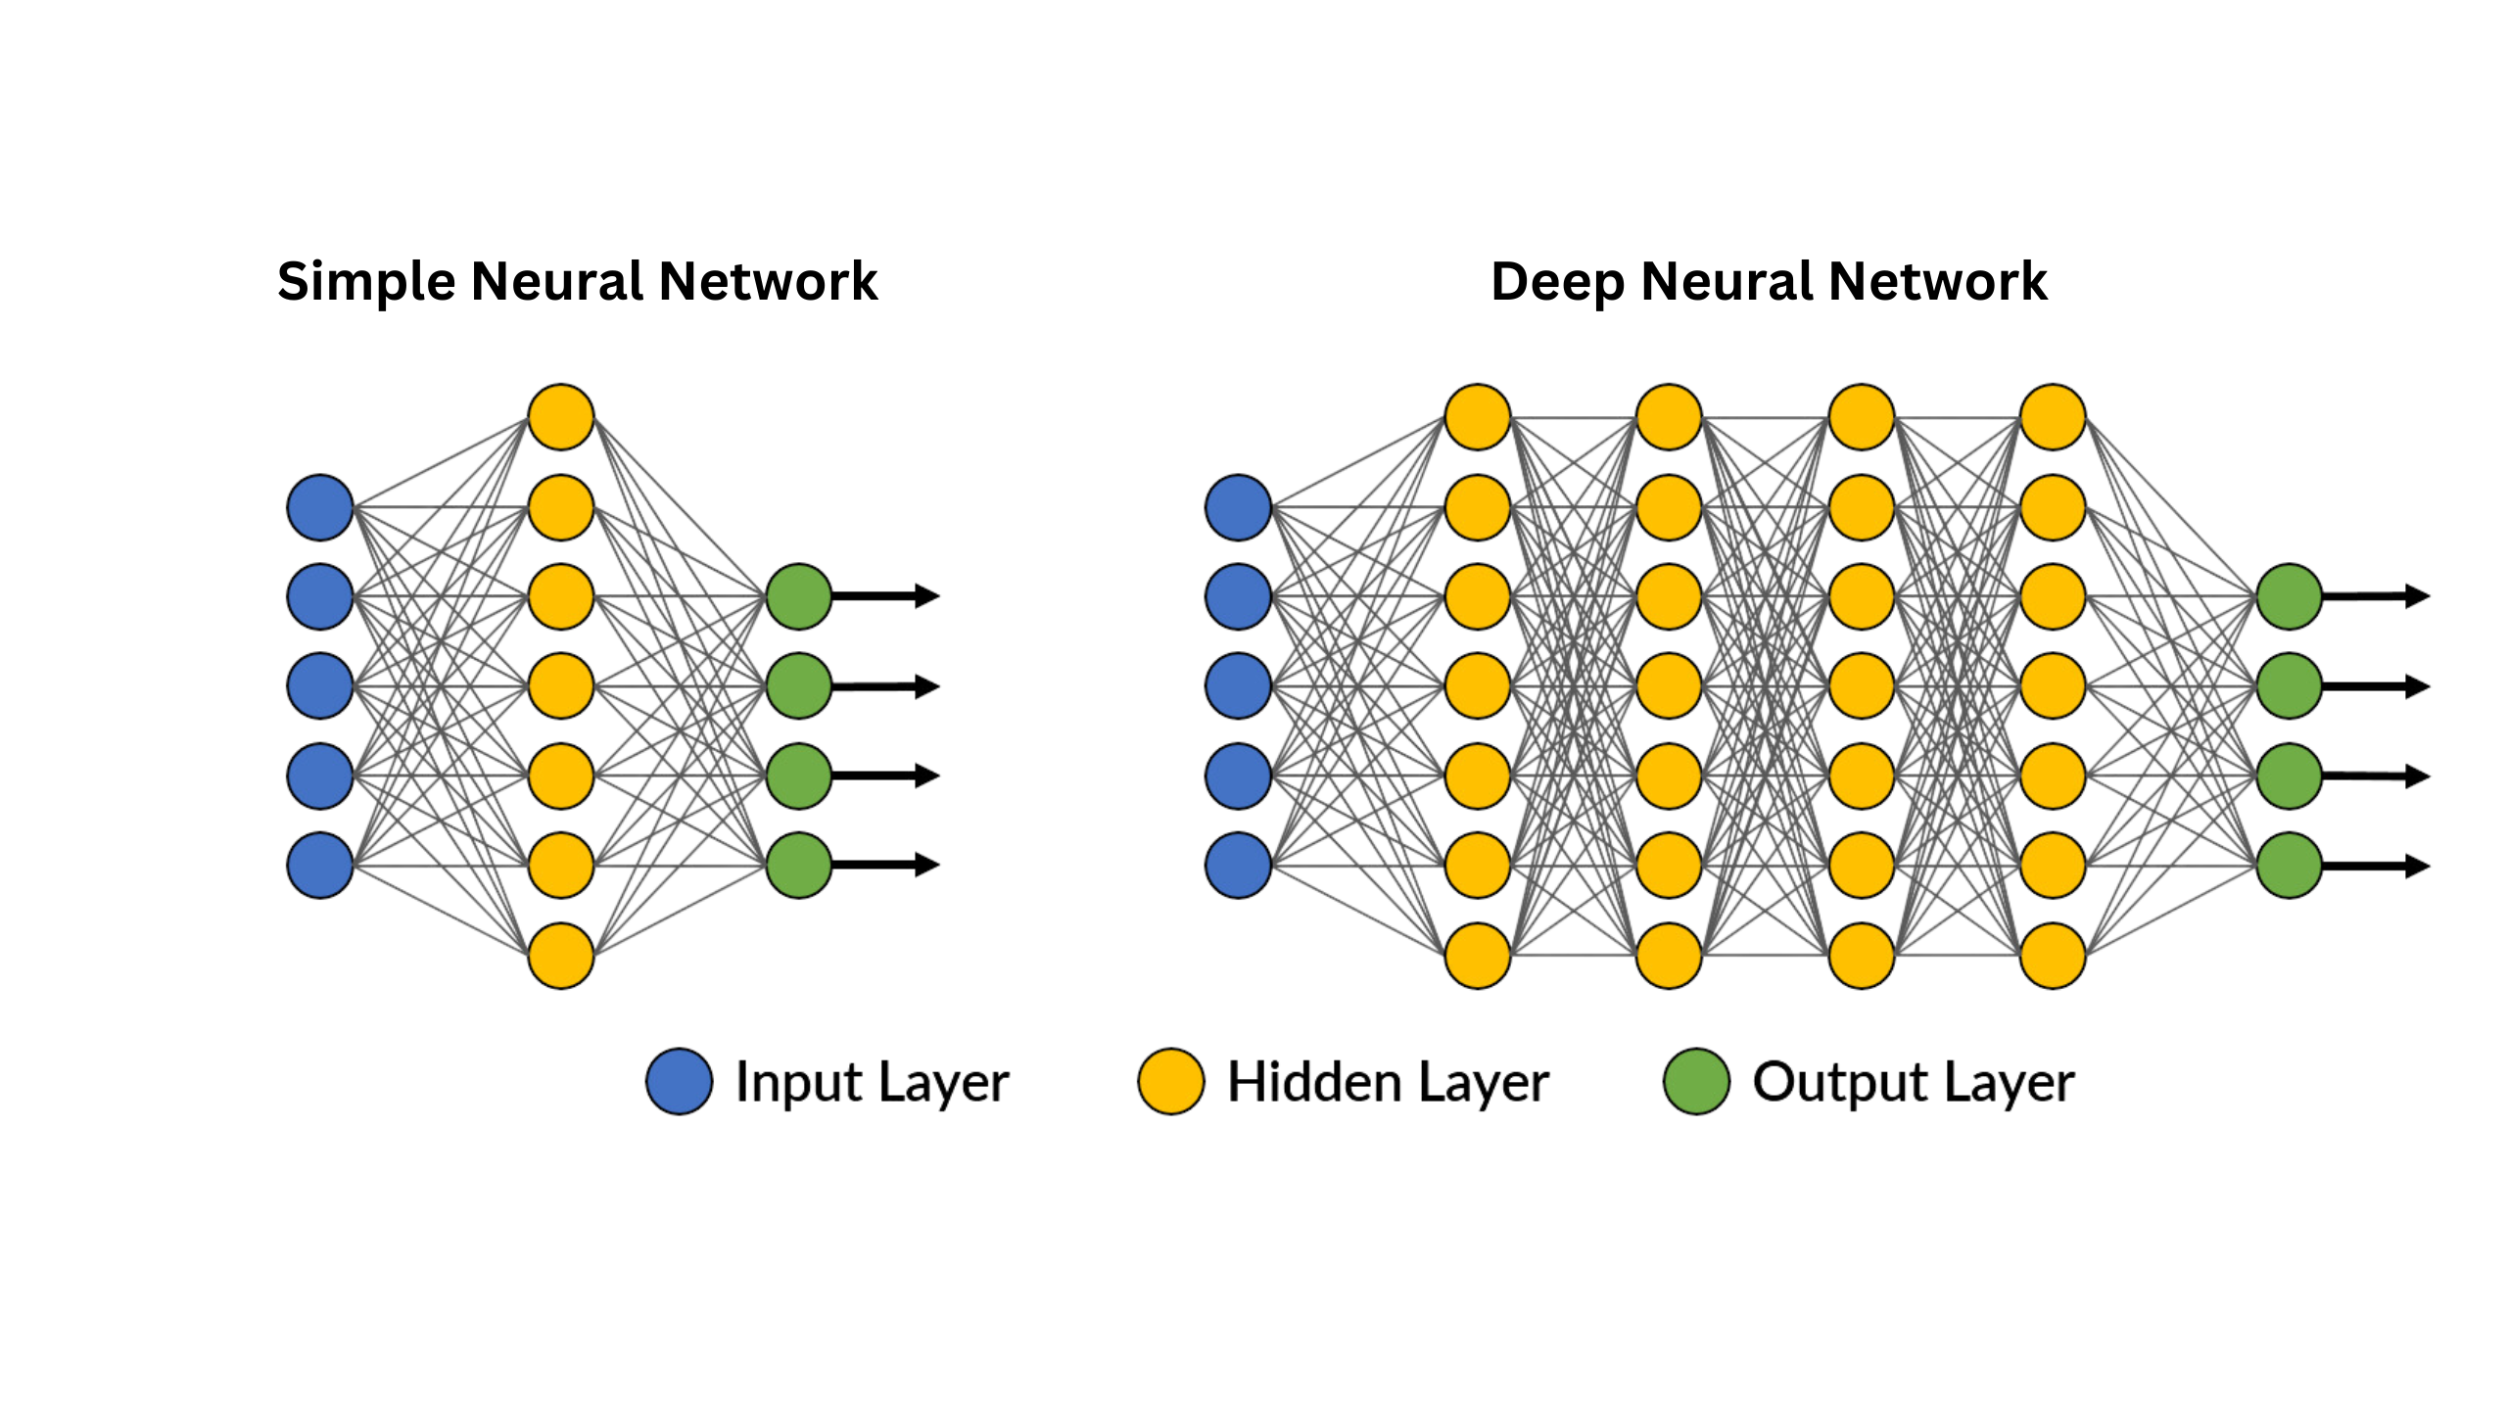

Slide 51


Slide 52
Deep Learning
Neural Networks
Feedforward Neural Networks
Recurrent Neural Networks
Convolutional Neural Networks
Other NN Architectures
(FNNs)
(RNNs)
(CNNs)
Generative Adversarial Networks (GAN)
Vanilla RNNs
Long Short-Term Memory Networks
Autoencoders
Transformer Networks
(LSTMs)

Slide 53
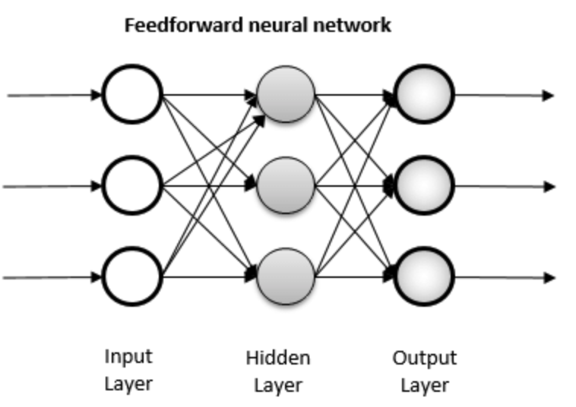
Feedforward Neural Networks
These are the basic type of Neural Network where information moves in one direction, it only moves forward.
No memory
Order of the data does not matter
Eg: Image Recognition

Slide 54
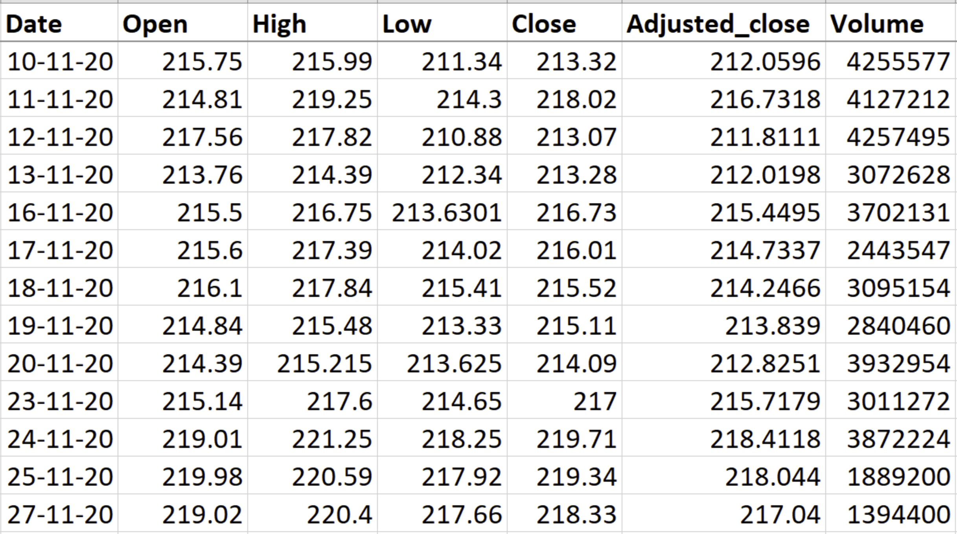

Slide 55
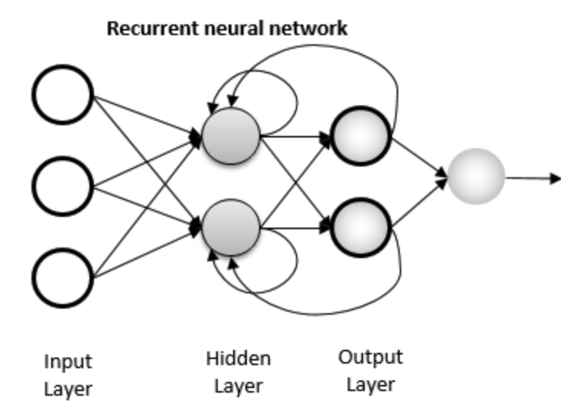
Recurrent Neural Networks
Recurrent Neural Networks (RNNs) are a type of neural network designed to process sequential data, where the order of information matters.
Built-in Short-Term Memory
High
Low
Close
Volume, etc

Slide 56
Convolutional Neural Networks
The convolutional neural network is mostly used to analyse visual data, like images and videos.

Slide 57
Recurrent Neural Networks
Recurrent Neural Networks (RNNs) are a type of neural network designed to process sequential data, where the order of information matters.
Built-in Short-Term Memory

Slide 58
Recurrent Neural Networks
I am born in France. So, I can talk _____
French
“I” – someone is talking about themselves
“am” – understands it’s in the present tense
“born” – the person is talking about their birth
“in” – expects a place
“France” – they were born in france
“So” – there’s a conclusion coming
“I” – the person is still talking about themselves
“can” – they’re able to do something
“talk” – they can talk
(Prediction) – French

Slide 59
Anaconda
Comprehensive distribution that includes a package manager “conda”
Large collection of pre-installed libraries and tools
Used for more advanced data science & machine learning projects
Miniconda
Lighter version of Anaconda
Includes package manager “conda”
Comes with essential tools, sufficient for most of the machine learning projects

Slide 60
Stock Prediction
1. Data Collection
6. Model Building
2. Data Exploration & Visualization
7. Model Training
3. Feature Engineering
8. Making Predictions
4. Data Preprocessing
9. Preparing Test Data
5. Sequence Creation
10. Model Evaluation

Slide 61
Stock Prediction – Data Preprocessing
Splitting the data into Training & Testing
70%
30%
Training
Testing
0%
100%

